Slide 1
SEMANTIC JOB CANDIDATE RECOMMENDATION ENGINE
Project - 11
Group - 52
Mentor - Soumyajit Ganguly and Anurag Tyagi
Sachin Baldua : 201330082
Sikander Sharda : 201301159
Nausheen Fatma : 201407541

Slide 2
Problem Statement
A recruiter wants to select the best CVs which suit his job requirement. To do this, one need to semantically match the words mentioned by candidate in the resume to those mentioned in the job description and get the best candidates suitable for the job. We need to design a search engine which takes the requirements of the job such as the skills and the position as the input and outputs a ranked list of CV in order of their relevance to the opening.

Slide 3
Applications
A particular job vacancy may receive huge number of applications.Manually sorting the CVs is practically impossible.Sorting out the suitable CVs from thousands(or possibly lakhs) of applications is a very challenging problem.We aim to build a system in which given a job title/description(query),the system can retrieve the suitable CVs(documents) and rank them according to some relevance measure .
This can be applied in various job portals/websites such as LinkedIn,monster.com, theladder.com,etc. to select CVs for a particular job.
Similar recommendation systems has widely been used in various applications such as music, movie(Youtube), product(Flipkart,Amazon), computational advertisements,news articles recommendation systems,where a new item is recommended by modelling the behaviour of past history of user selections.

Slide 4
Challenges
Following are the major challenges we faced in this project:
Feature identification and extraction from varying CV formats and styles such as tabular data or basic text from both pdfs and markup language format.
Extracting data related to the person and his skills by suitable regex and other similar techniques.
Identifying CVs of different domains of job offerings such as android,web development, networking,etc.
Extracting different forms of technologies like frameworks,languages etc and the corresponding job domains they are primarily used for. This also includes including all naming techniques of these technologies. For example C++ can also be written as cpp or different modules can refer to the same or different languages/domains such as nltk or pygame which refer to different job domains.
Different ranking algorithms which can be used to rank the shortlisted CVs corresponding to a job requirement.

Slide 5
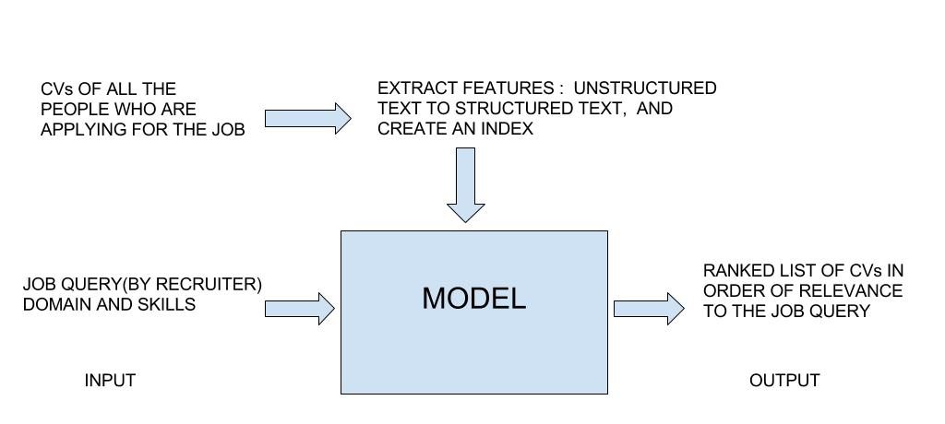
MODEL

Slide 6
Procedure
Extracting the text : As most of the CV are in pdf formats, this becomes a major problem. Many modules do not convert the tables in pdf format properly into text files. This results in complication related to data of the individual. The most suitable module to perform this task is Java’s pdfbox which can convert table rows into simple lines in text format.
Applying regex to retrieve data from the text files: Using regex and simple conventional techniques, we can find out the name, college, highest degree, phone number, email-id , etc of the individual. This knowledge helps us to recognise the individual. We also built a User-Interface in which a resume in pdf format was uploaded and it gave output as the information of the individual. This part was performed in the second deliverable.

Slide 7
Second Deliverable

Slide 8
Procedure (Continued)
Extracting list of frameworks, languages, job domains, modules etc : This helps us later to extract the terms using bag of words concepts from the text files of the CVs and can later be used to match them to the most suitable CV according to the job requirement given by the user.
Applying tf-idf method on the parsed CVs: After extracting all the (personal information and ) skills of the individual related to languages,frameworks,jobs, etc we need to apply tf-idf score to each of the terms using Scikit Library thus providing us with a ranked list of all the CVs corresponding to a job requirement query. The functionality is implemented on the terminal itself.This is implemented in the third deliverable.

Slide 9
Third Deliverable

Slide 10
Further Improvements
This system can be provided with many other features to ensure better results such as :
Going beyond simple word matching,and doing meaning based search.This is quite challenging as simply adding the synonyms can be disastrous. For example,imagine if we add the synonyms for terms like Spark, Pig, Hive. It can worsen and add incorrect features instead of improving it.Also utility like Wordnet (which gives synsets,hypernyms,hyponyms) is not available for such technical terminologies.
Modelling concepts for feature representation from words (for example C++ ,Java and Object oriented programming may represent one single concept(therefore one single dimension) rather than 3 different concepts) and identifying hierarchy of concepts (example Neural networks,Nearest neighbours,SVMs belongs to Machine learning concept).We can make better systems if we could model these concepts as features rather than treating each word as a separate feature,and apply similarity measures on these representations.
Taking the duration of a work experience into account to represent the proficiency of an individual at a particular skill. This also tells us the positions of responsibility the individual has worked at.
Identifying CVs of different domains such as engineering, arts , commerce, etc.

